Slide 1


DashPass Loyalty
Quant Research Results
Kelly Peterson UXR
Jan 2023

Slide 2
Research Goals
Understand how different DashPass Cx segments perceive the value of DashPass and the potential value of a DashPass loyalty program.
1.
How do DashPass user segments differ in their perceptions of DashPass value, if at all?
2.
What loyalty programs do DashPass Cx use today and how do they feel about them?
3.
Are DashPass Cx interested in a loyalty program? What benefits would the program need to increase ordering and retention?

Slide 3


Research Approach
1:1 Interviews
Survey
SURVEY RESEARCH PARTICIPANTS
Survey (n=2,708 DashPass Cx)
Power Cx | 571
Habit Cx | 256
Core Net Saver | 575
Low Net Saver | 262
Net Loser | 303
Dormant Cx | 164
Early Paid Subs | 285
Trial Cx | 292
1:1 moderated interviews with DashPass Cx segments
Participants were asked about their current loyalty program experiences and then shown two potential loyalty experiences (rewards & tiers).
See full results here
10 min Survey
N=2708 DashPass Cx completed an online survey including DashPass experience, loyalty program experience and benefits tests using MaxDiff, TURF and preference scales.
See research brief here
Data weighted so total includes accurate distribution of segments
Cx had to be aware of DoorDash to participate
Cx could not be on partnered or student plan to participate
Notes:
James to link to failed session

Slide 4
Who are the segments?
Segments were developed based on the tenure with DashPass and their ordering frequency:
Name | Sample (unweighted) | % of total paid subs | Tenure | Segment Definition
Power Cx | 571 | 13% | Paid 4+ Months | 11+ orders per month on average
Habit Cx | 256 | 6.5% | Paid 4+ Months | 7-10 orders per month on average
Core Net Saver | 575 | 13% | Paid 4+ Months | 4-6 orders per month on average
Low Net Saver | 262 | 6.5% | Paid 4+ Months | 2-4 orders per month on average
Net Loser | 303 | 13% | Paid 4+ Months | <2 orders per month on average
Dormant Cx | 164 | 13% | Paid 4+ Months | No orders past 30 days
Early Paid Subs | 285 | 25.1% | Paid months 1-3 | Paid months 1-3
Trial Cx | 292 | 9.7% | In Trial | In Trial

Slide 5

How do DashPass segments differ in perceptions?

Slide 6
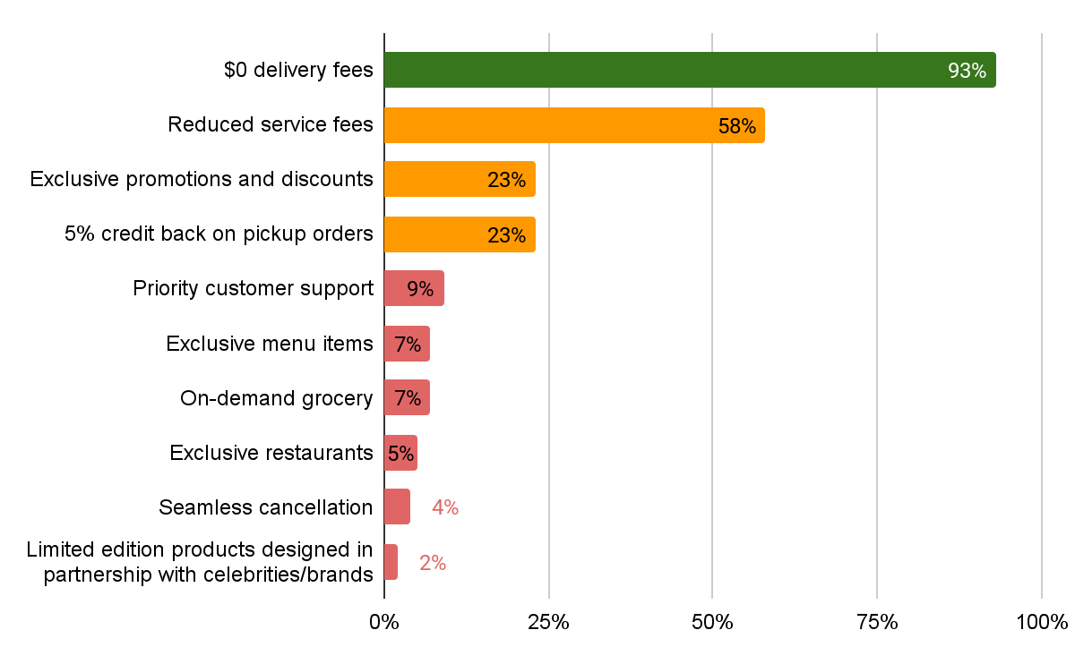
Little knowledge of benefits outside of delivery fees, especially for Trial Cx
Awareness of DashPass Benefits
Trial Cx
93%
46%↓
18%↓
12%↓
6%
5%
3%
4%
2%
1%
No significant differences in awareness among segments, except for trial users who are less likely to be aware of financial benefits outside of $0 delivery
Which of the following do you receive as a DashPass member? Please select all that apply.
Total N=2708, Power Cx n=571, Habit Cx n=256, Core Net Savers n=575, Dormant Cx n=164, Low Net Saver n=262, Net Loser n=352, Early Paid Subs n=285, Trial Cx n=292

Slide 7
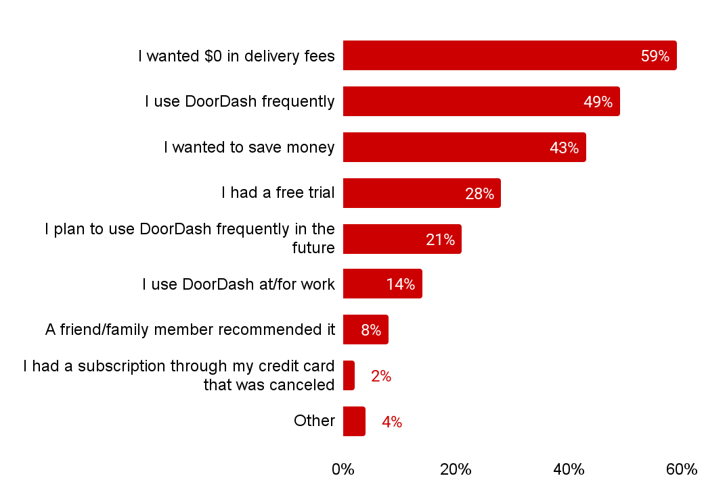
Interest in DashPass primarily driven by $0 delivery fees & existing ordering behaviors
 | Power Cx | Habit Cx | Core Net Saver | Low Net Saver | Net Loser | Dormant Cx | Early Paid Subs | Trial Cx
 | 63% | 64% | 64% | 63% | 63% | 56% | 57% | 50%↓
 | 70%↑ | 57%↑ | 62%↑ | 50% | 44% | 40% | 42% | 30%↓
 | 45% | 50%↑ | 44% | 43% | 43% | 47% | 40% | 39%
 | 19% | 22% | 19% | 26% | 21% | 25% | 33% | 57%↑
 | 30%↑ | 27% | 21% | 21% | 21% | 17% | 18% | 19%
 | 16% | 15% | 14% | 18% | 15% | 10% | 15% | 12%
 | 6% | 6% | 6% | 6% | 11% | 8% | 8% | 10%
 | 1% | 2% | 1% | 2% | 2% | 2% | 2% | 1%
 | 3% | 4% | 5% | 5% | 4% | 4% | 4% | 2%
Reasons why first signed up for DashPass
Why did you first sign up for DashPass?
Total N=2708, Power Cx n=571, Habit Cx n=256, Core Net Savers n=575, Dormant Cx n=164, Low Net Saver n=262, Net Loser n=352, Early Paid Subs n=285, Trial Cx n=292

Slide 8
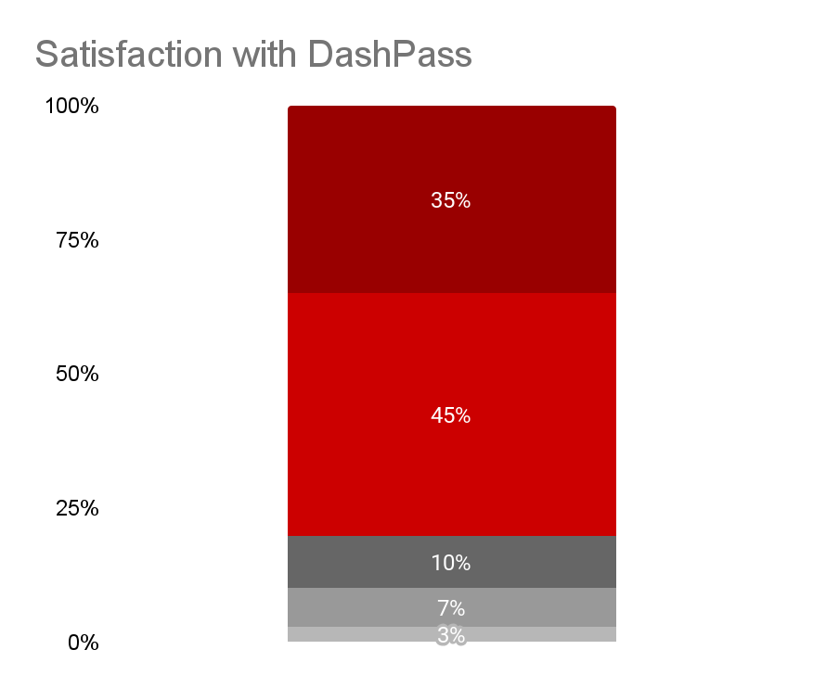
All segments are fairly satisfied with DashPass with lowest satisfaction among Dormant Cx
Extremely Satisfied
Power Cx | Habit Cx | Core Net Saver | Low Net Saver
84% | 83% | 84% | 82%
79% Extremely or somewhat satisfied with DashPass
Net Loser | Dormant Cx | Early Paid Subs | Trial Cx
83% | 70% ↓ | 77% | 75%
Somewhat Satisfied
Neither Satisfied nor dissatisfied
Somewhat Dissatisfied
Extremely Dissatisfied
How would you rate your overall satisfaction with using DoorDash DoorDash Pass?
Total N=2708, Power Cx n=571, Habit Cx n=256, Core Net Savers n=575, Dormant Cx n=164, Low Net Saver n=262, Net Loser n=352, Early Paid Subs n=285, Trial Cx n=292

Slide 9




DP Cx feel they have better experiences because of DashPass, with the exception of CS
Because of DashPass I have….
(Extremely or Somewhat Agree)
Saved Money
Saved Time
Positive Dasher Experiences
Better Customer Service Experiences
67%
70%
60%
44%
** No significant differences noted among segment responses compared to total
Using the scale below, please indicate how much you agree or disagree with the following statements
Total N=2708, Power Cx n=571, Habit Cx n=256, Core Net Savers n=575, Dormant Cx n=164, Low Net Saver n=262, Net Loser n=352, Early Paid Subs n=285, Trial Cx n=292

Slide 10
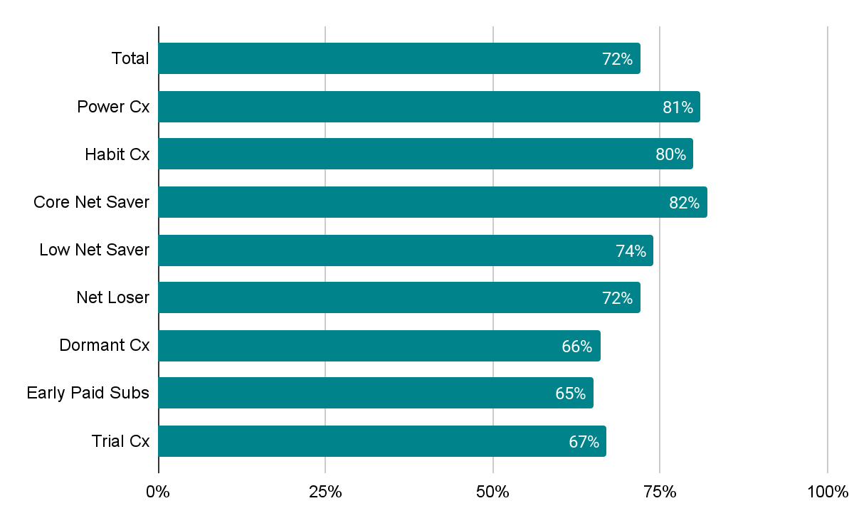

Perceived DashPass value is correlated with DashPass use & dollars saved
DashPass is Worth It
(Extremely or Somewhat Agree)
Using the scale below, please indicate how much you agree or disagree with the following statements
Total N=2708, Power Cx n=571, Habit Cx n=256, Core Net Savers n=575, Dormant Cx n=164, Low Net Saver n=262, Net Loser n=352, Early Paid Subs n=285, Trial Cx n=292

Slide 11
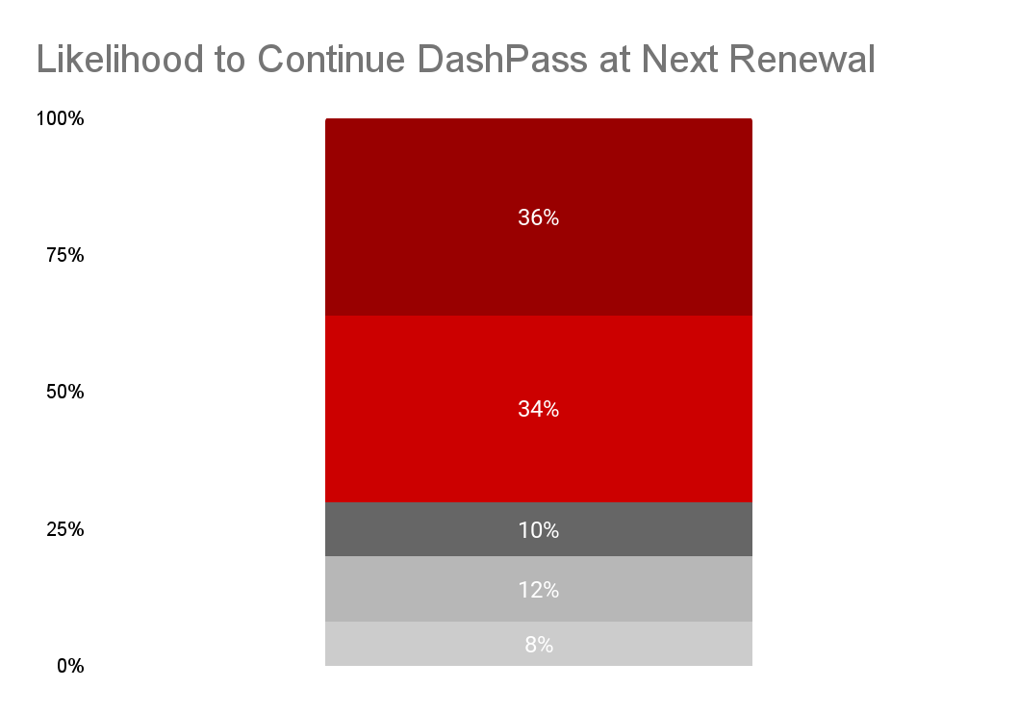
One-third of DashPass Cx are unsure or unlikely to renew their subscription
Extremely Likely
Power Cx | Habit Cx | Core Net Saver | Low Net Saver
79% ↑ | 74% | 76% | 69%
70% Extremely or somewhat likely to renew DashPass
Net Loser | Dormant Cx | Early Paid Subs | Trial Cx
74% | 62% ↓ | 67% | 57% ↓
Somewhat Likely
Neither Likely nor Unlikely
Somewhat unlikely
Extremely unlikely
How likely are you to continue/renew/sign up for your DashPass subscription at the next renewal?
Total N=2708, Power Cx n=571, Habit Cx n=256, Core Net Savers n=575, Dormant Cx n=164, Low Net Saver n=262, Net Loser n=352, Early Paid Subs n=285, Trial Cx n=292

Slide 12
Dormant Cx tend to be 50+ while trial tend to be 18-29
 | Total | Power Cx | Habit Cx | Core Net Saver | Low Net Saver | Net Loser | Dormant Cx | Early Paid Subs | Trial Cx
Age
18-29 | 20% | 19% | 16% | 18% | 13%↓ | 15% | 16% | 24% | 32%↑
30-39 | 31% | 32% | 33% | 32% | 31% | 30% | 26% | 30% | 31%
40-49 | 25% | 25% | 25% | 26% | 25% | 27% | 26% | 22% | 23%
50+ | 25% | 25% | 26% | 25% | 31% | 29% | 32%↑ | 23% | 15%↓
Location
Major metro city | 9% | 8% | 11% | 8% | 11% | 9% | 10% | 7% | 9%
City | 34% | 34% | 35% | 32% | 27%↓ | 26%↓ | 38% | 37% | 41%↑
Suburb/Town | 34% | 37% | 34% | 40% | 39% | 36% | 33% | 33% | 24%↓
Town | 12% | 12% | 11% | 10% | 15% | 14% | 10% | 12% | 10%
Rural area/ Countryside | 7% | 6% | 5% | 7% | 4% | 11% | 6% | 6% | 10%
Total N=2708, Power Cx n=571, Habit Cx n=256, Core Net Savers n=575, Dormant Cx n=164, Low Net Saver n=262, Net Loser n=352, Early Paid Subs n=285, Trial Cx n=292

Slide 13
Dormant Cx & Net Losers tend to have fewer people in the HH
 | Total | Power Cx | Habit Cx | Core Net Saver | Low Net Saver | Net Loser | Dormant Cx | Early Paid Subs | Trial Cx
Marital Status
Married/Partnered | 42% | 44% | 48% | 50% | 52%↑ | 48% | 39% | 36% | 32%↓
Single | 39% | 34% | 38% | 34% | 26%↓ | 35% | 38% | 45% | 51%↑
# of People in HH
Average (including self) | 2.9 | 2.95 | 2.83 | 2.8 | 3.01 | 2.76↓ | 2.73↓ | 2.95 | 3.25↑
Education
High school /GED | 13% | 10% | 11% | 11% | 9% | 9% | 15% | 14% | 27%↑
Some college or associates | 35% | 37% | 34% | 31% | 35% | 36% | 37% | 37% | 30%
Bachelor's degree or higher | 46% | 47% | 52%↑ | 53%↑ | 49% | 51% | 45% | 41% | 36%↓
Income
$49,999 or less | 28% | 25% | 22% | 20%↓ | 20%↓ | 20%↓ | 28% | 34% | 45%↑
$50,000-$99,999 | 30% | 28% | 28% | 31% | 30% | 35% | 29% | 28% | 25%
$100,000+ | 27% | 28% | 33% | 32% | 36%↑ | 29% | 27% | 23% | 16%↓
Total N=2708, Power Cx n=571, Habit Cx n=256, Core Net Savers n=575, Dormant Cx n=164, Low Net Saver n=262, Net Loser n=352, Early Paid Subs n=285, Trial Cx n=292

Slide 14
A quick recap…
Overall trends
Segment specific insights
There are few differences between Cx user segments in their perceptions of DashPass
About three-quarters are respondents state they are happy with DashPass and likely to renew their membership
Most Cx are not aware of benefits other than $0 delivery
Cx feel DashPass saves them time and money but do not believe it provides them with a better customer service experience
Trial Cx are even less likely than subs to know DashPass benefits beyond $0 delivery and are less likely to “renew”. They tend to be younger (18-29), single and live in a city
Dormant Cx are less satisfied with DashPass & less likely to renew. They tend to be 50+ with fewer individuals in the household
Segments that are highly active on DoorDash (Power, Net Savers, Core Savers) tend to have the highest satisfaction with DashPass

Slide 15
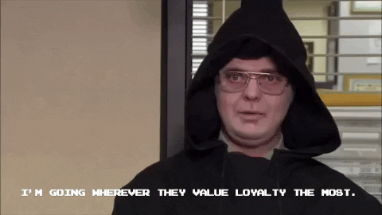
What are DashPass Cx current loyalty experiences?

Slide 16
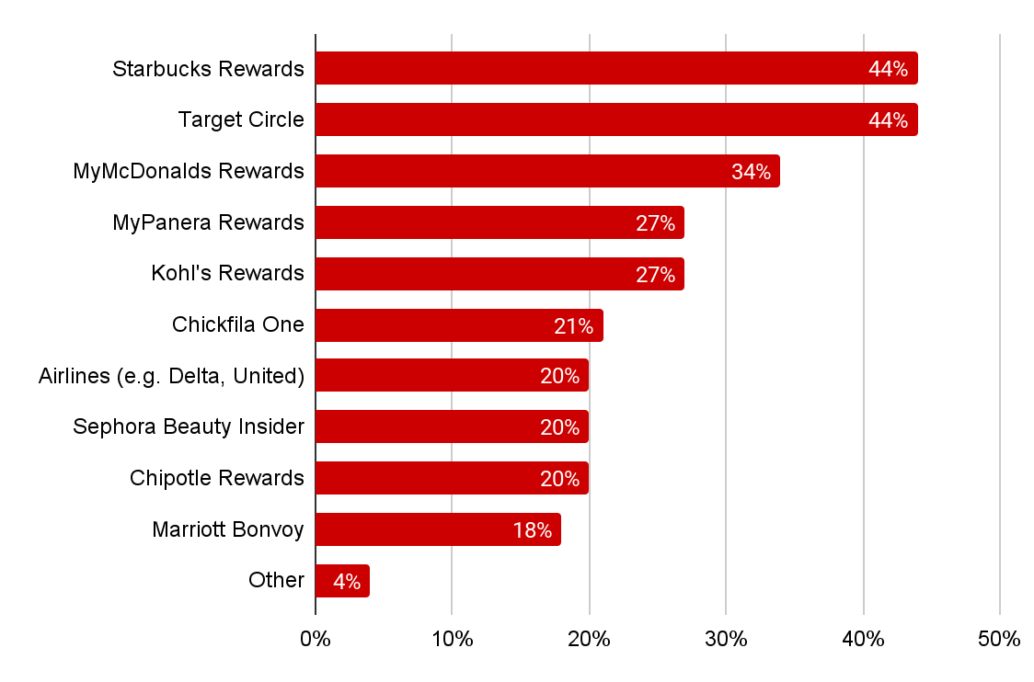
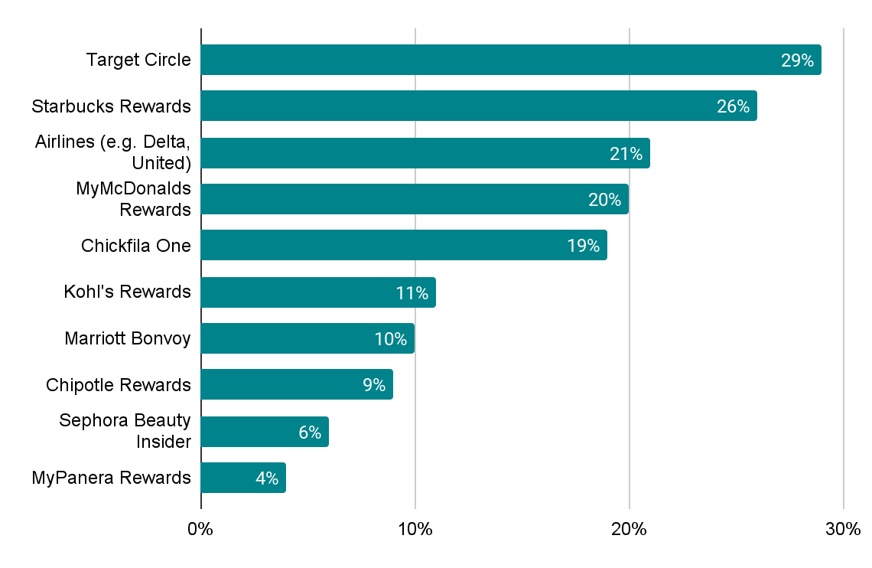
Starbucks & Target loyalty programs are viewed as top tier among DashPass Cx
Current Loyalty Programs Used
Loyalty Program Ranked #1
Average # of programs used= 2.79
See next slide for segment level differences
Do you currently participate in any of the following loyalty programs?
Earlier you stated that you participate in the following loyalty programs. Please rank these programs from those that are most valuable to you, to those that are least valuable to you.
Total N=2708, Power Cx n=571, Habit Cx n=256, Core Net Savers n=575, Dormant Cx n=164, Low Net Saver n=262, Net Loser n=352, Early Paid Subs n=285, Trial Cx n=292

Slide 17
Use of Loyalty Programs
 | Total | Power Cx | Habit Cx | Core Net Saver | Low Net Saver | Net Loser | Dormant Cx | Early Paid Subs | Trial Cx
Starbucks Rewards | 44% | 41% | 47% | 46% | 50% | 47% | 46% | 42% | 39%↓
Target Circle | 44% | 41% | 46% | 45% | 49% | 45% | 48% | 44% | 35%↓
MyMcDonalds Rewards | 34% | 26%↓ | 30% | 25%↓ | 40% | 35% | 44%↑ | 34% | 37%
MyPanera Rewards | 27% | 28% | 29% | 28% | 31% | 28% | 27% | 28% | 19%↓
Kohl's Rewards | 27% | 24% | 29% | 28% | 35%↑ | 30% | 26% | 28% | 20%
Chickfila One | 21% | 20% | 24% | 18% | 26% | 24% | 16% | 24% | 17%
Airlines (e.g. Delta, United) | 20% | 19% | 24% | 22% | 28% | 21% | 23% | 17% | 13%
Sephora Beauty Insider | 20% | 19% | 22% | 20% | 19% | 20% | 23% | 21% | 14%
Chipotle Rewards | 20% | 16% | 21% | 18% | 22% | 20% | 24% | 21% | 16%
Marriott Bonvoy | 18% | 18% | 16% | 19% | 23% | 17% | 21% | 18% | 13%
Other | 4% | 2% | 2% | 2% | 5% | 5% | 4% | 6% | 3%
None of the above | 20% | 23% | 19% | 21% | 15% | 16% | 16% | 22% | 28%↓
Do you currently participate in any of the following loyalty programs?
Earlier you stated that you participate in the following loyalty programs. Please rank these programs from those that are most valuable to you, to those that are least valuable to you.
Total N=2708, Power Cx n=571, Habit Cx n=256, Core Net Savers n=575, Dormant Cx n=164, Low Net Saver n=262, Net Loser n=352, Early Paid Subs n=285, Trial Cx n=292

Slide 18

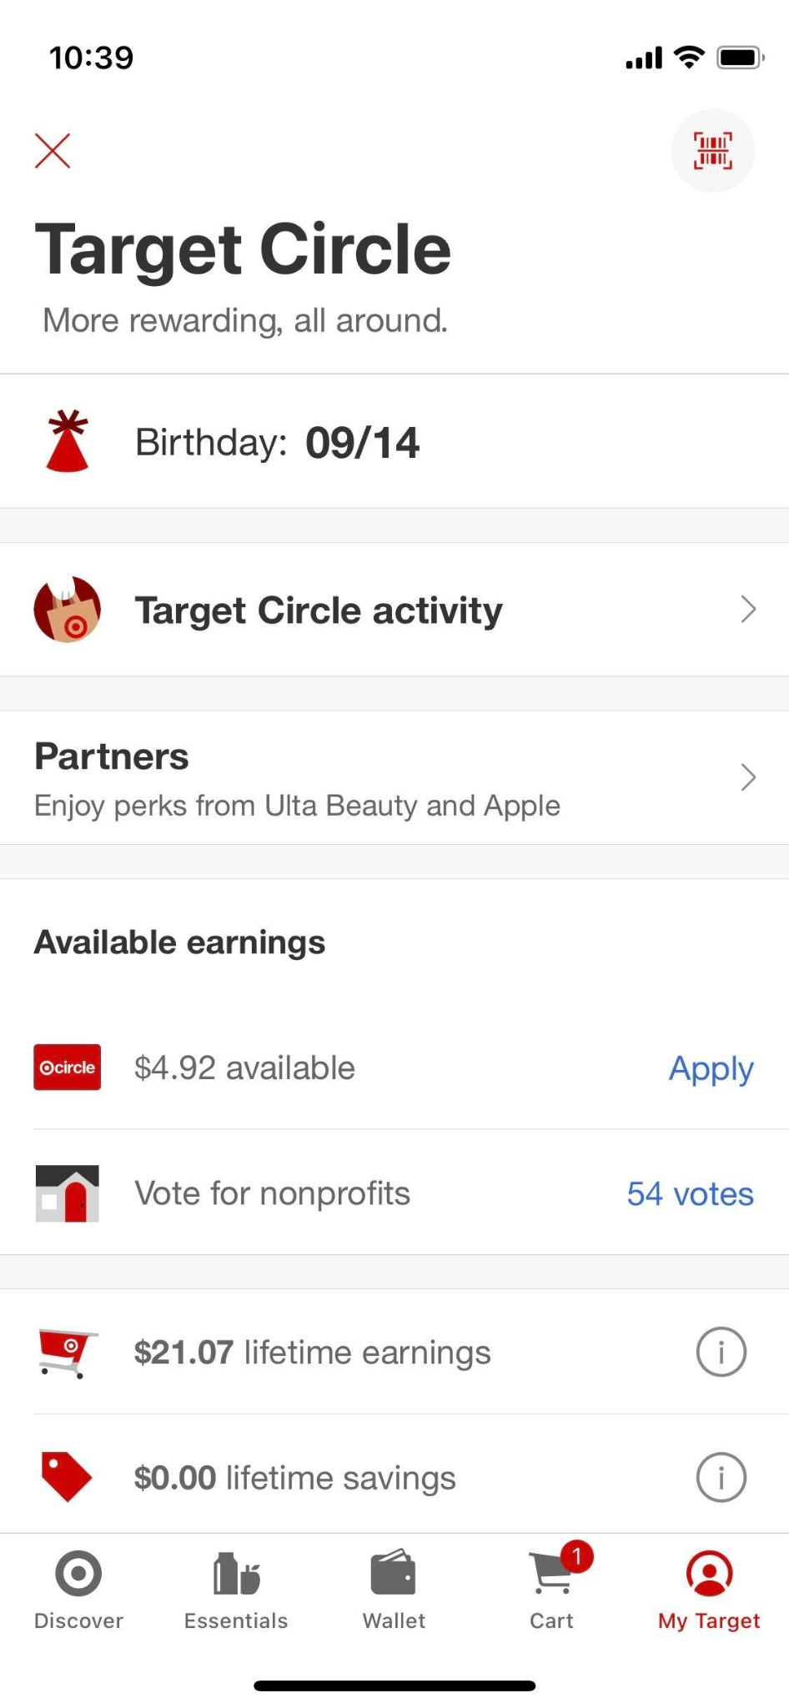
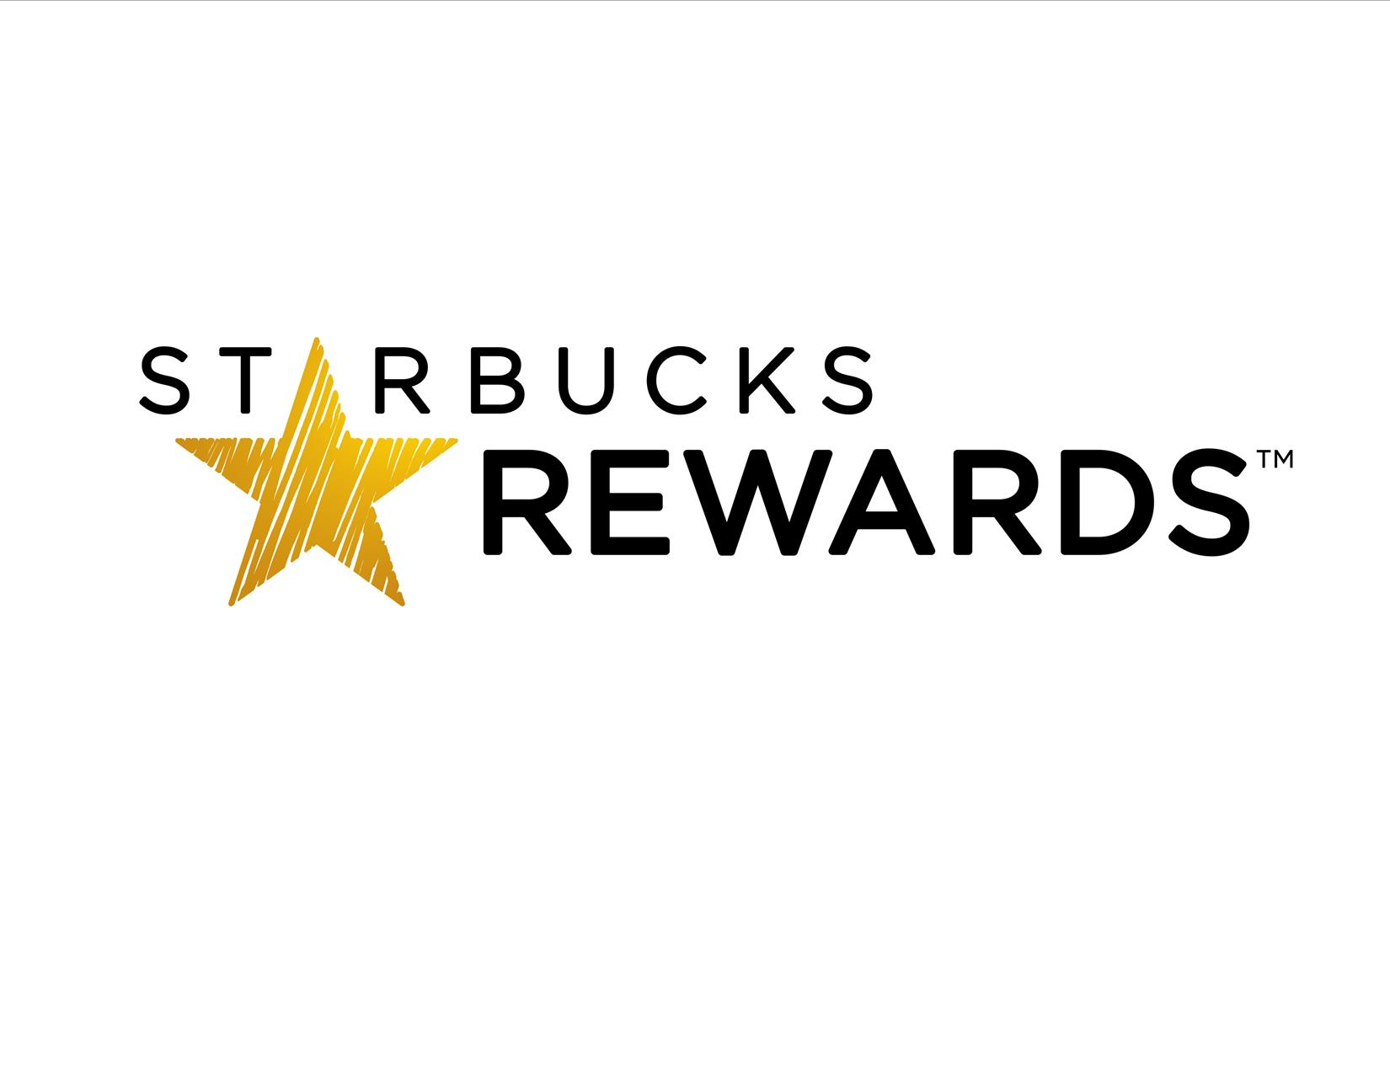
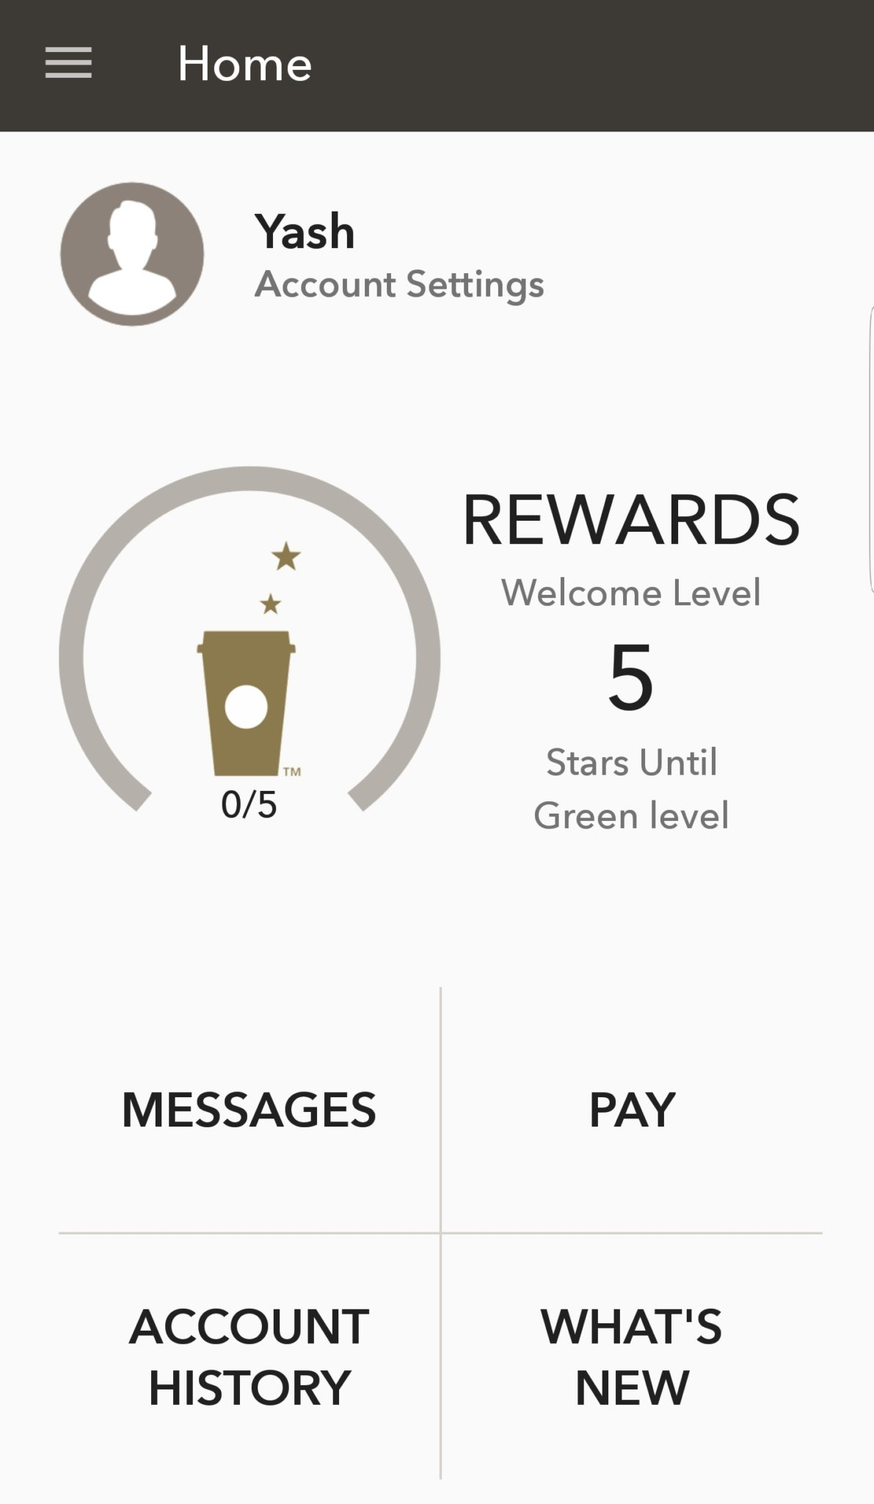
Earning monetary rewards quickly drives Cx satisfaction with Target & Starbucks loyalty programs
Cash back/ discounts
Accumulate rewards quickly
Frequent deals/ coupons
Easy to see rewards & savings
Free food/frequent discounts
Rewarded frequently/for every dollar
Daily coupons
Free drink on birthday
Thinking about the loyalty programs you ranked highly, what benefits, features or experiences make them stand out?
Total N=2708

Slide 19

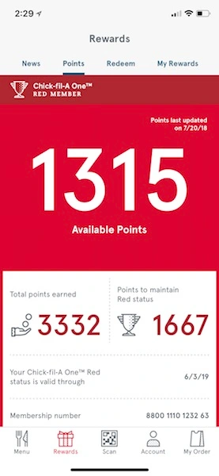
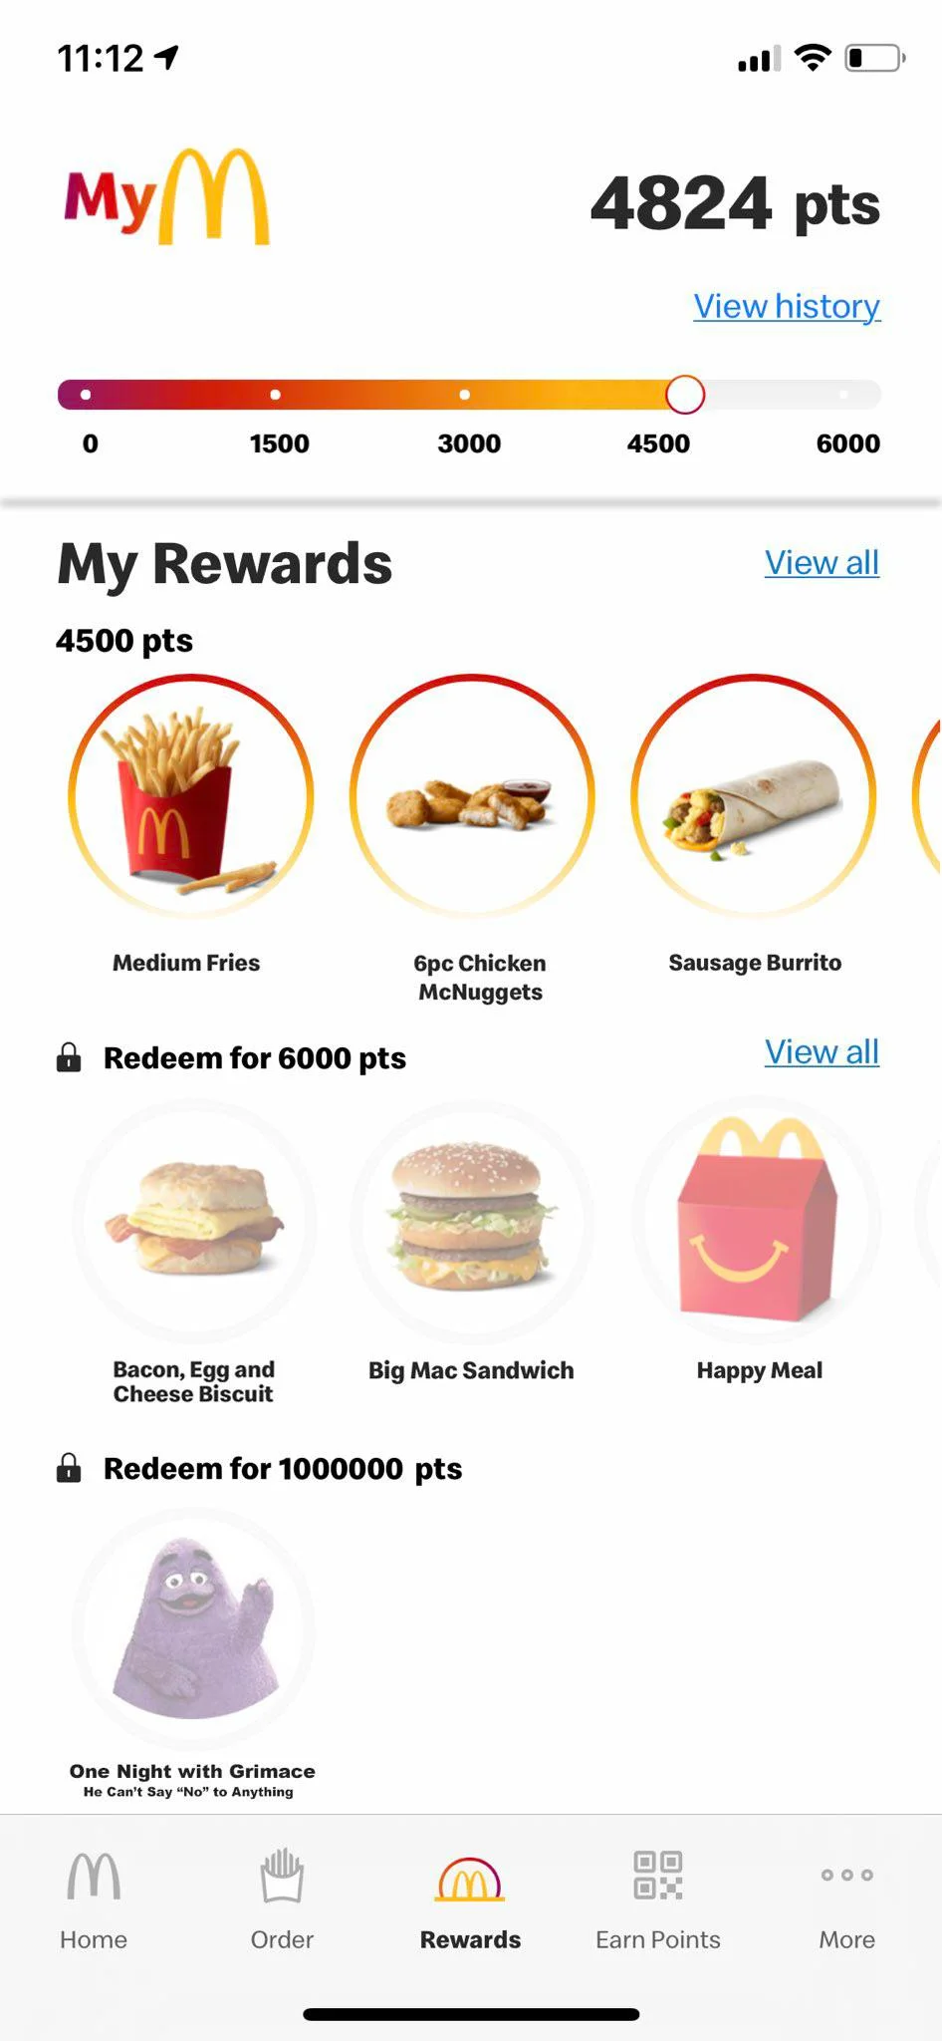

Top restaurant apps are successful because you “earn” with every order and get full free meals in return
Accumulate rewards quickly
Discounts
Free fries
Earn rewards on every order
Free food
Easy to cash in
Thinking about the loyalty programs you ranked highly, what benefits, features or experiences make them stand out?
Total N=2708

Slide 20
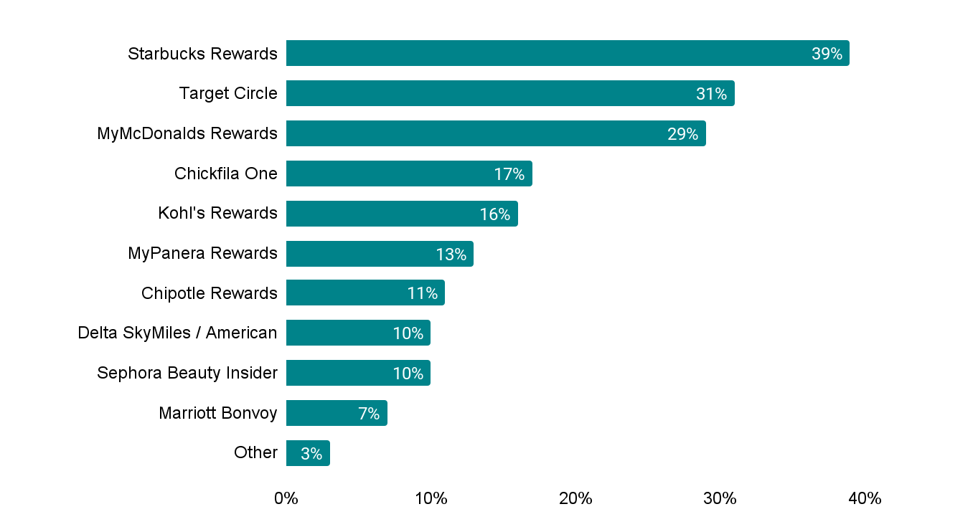






Unclear and ever changing rules can discourage Cx from active loyalty participation
Most clear/easy to understand programs
What makes a program unclear?
 | Don’t use it enough
 | Changing guidelines/restrictions/fine print
 | Difficult to cash in on rewards
 | Requirements to cash in/get to next tier are confusing
 | Some locations do not participate
 | Frequent app glitches/errors/updates
Earlier you stated that you participate in the following loyalty programs. Please select the programs that you find the most clear/easy to understand. Please select up to 3 responses.
Thinking about the loyalty programs that you did not select as most clear/easy to understand, what makes them confusing or difficult at times?
Total N=2708, Power Cx n=571, Habit Cx n=256, Core Net Savers n=575, Dormant Cx n=164, Low Net Saver n=262, Net Loser n=352, Early Paid Subs n=285, Trial Cx n=292

Slide 21
A quick recap…
Starbucks, Target Circle, Airlines, MyMcDonalds & Chickfila are top rated loyalty programs
To be highly rated, a loyalty program must;
Provide rewards with every purchase
Make it easy to redeem rewards, or do so automatically
Rewards should have real monetary value
Provide additional coupons/discounts
Cx find Chipotle, Panera and Airline rewards programs confusing
Programs are confusing because:
Guidelines to redeem rewards are changing
Lots of fine print on how to earn rewards
Rewards are not relevant to the individual

Slide 22

What benefits will interest DashPass Cx in a loyalty program?

Slide 23
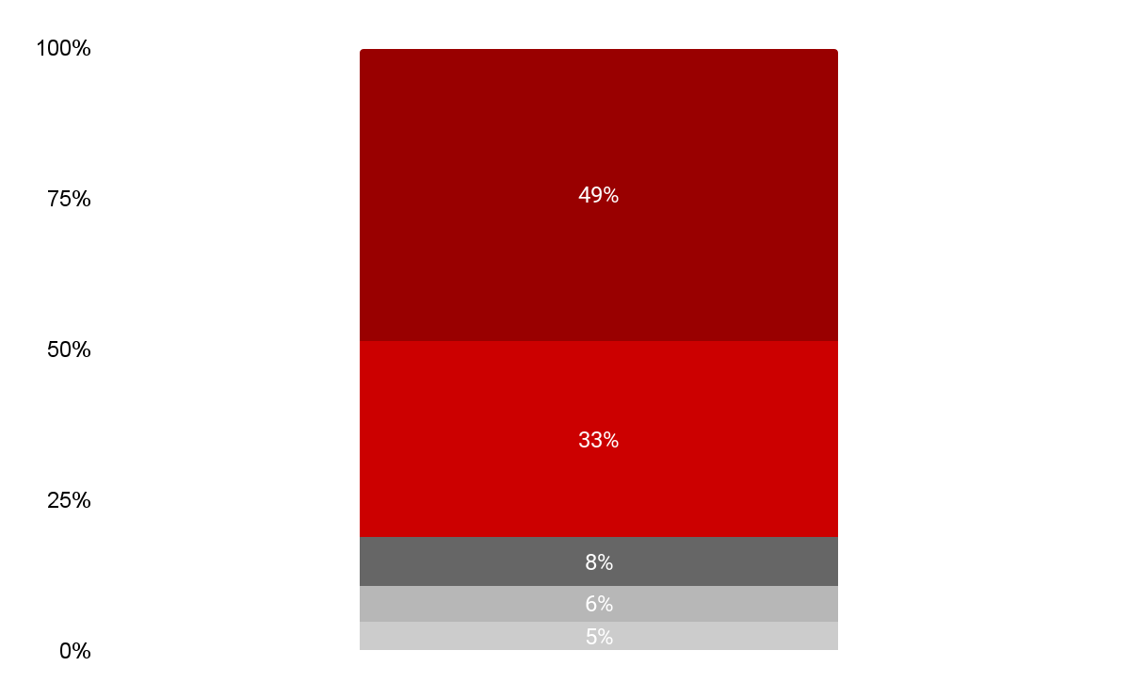
DashPass Cx are open to participating in a loyalty program with the greatest excitement among Power & Habit Cx
Interest in participating in tiered loyalty program
Very interested
81% of DashPass Cx are very or somewhat interested in participating in a DashPass loyalty program
Power Cx | Habit Cx | Core Net Saver | Low Net Saver
88% | 88% | 85% | 83%
Net Loser | Dormant Cx | Early Paid Subs | Trial Cx
81% | 77% | 79% | 75%
Somewhat interested
Neither interested nor disinterested
Somewhat disinterested
Very disinterested
DashPass is considering offering a loyalty program, where the more you spend the more value you get in return. In this program, DashPass members earn rewards as they order, as well as points that unlock new benefits when they reach a higher tier. How interested are you in participating in a program like this for DashPass?
Total N=2708, Power Cx n=571, Habit Cx n=256, Core Net Savers n=575, Dormant Cx n=164, Low Net Saver n=262, Net Loser n=352, Early Paid Subs n=285, Trial Cx n=292

Slide 24
We tested 15 benefits across 4 key metrics
Benefits Tested:
Metrics Used:
Affordability
Free delivery and no service fees on orders $35+
1% cashback on every order, given to you in credit
Earn a $5 credit for every 10th order
On every 10th order, get an item for free (Up to $5)
Quality & Experience
Cancellation forgiveness, cancel within 10 mins and get a full refund
One free “Express Delivery” order per month
Exclusive VIP support when you need help
Rush Reorders: upgrade all incorrect re-orders to express deliveries for free
Best/experienced dasher assigned to your orders
Exclusives
Access to limited-edition, custom merchandise
Access to the exclusive flash deals from top restaurants
Free item everyday from popular restaurants
Free package pick up and drop off (e.g. FedEx, UPS) every month
Surprise & Delight
$10 credit on your birthday to use on any order you want
Weekly Free Lunch Sweepstakes: Chance to win free lunch every week
Which of the following benefits are most important and least important when deciding whether or not to spend more to reach a higher loyalty status?
How easy to understand is the benefit?
How useful is the benefit?
How likely are you to participate in the DoorDash loyalty program based on the benefit?
1.
2.
3.
4.

Slide 25
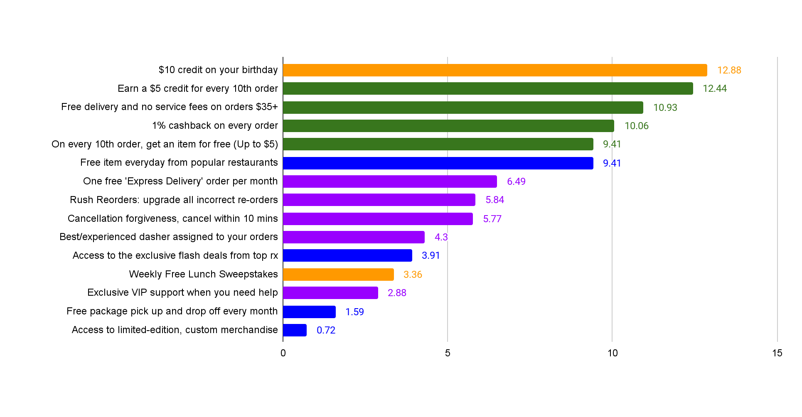
There must be at least one key affordability benefit in the top tier to ensure program success
Benefit Importance (MaxDiff- Items Sum to 100)
Tier 1: Affordability Must Haves
Tier 2: Quality Value Adds
Tier 3: Exclusives Low Impact
Surprise & Delight
Affordability
Exclusives
Quality & Experience
Which of the following benefits are most important and least important when deciding whether or not to spend more to reach a higher loyalty status.
Total N=2708, Power Cx n=571, Habit Cx n=256, Core Net Savers n=575, Dormant Cx n=164, Low Net Saver n=262, Net Loser n=352, Early Paid Subs n=285, Trial Cx n=292

Slide 26
Power & Habit Cx are most open to benefits that reward frequency while Dormant, Low Net Savers & Net Losers prefer expected/timed benefits
Benefit Importance (MaxDiff- Items Sum to 100)
 | Total | Power Cx | Habit Cx | Core Net Saver | Low Net Saver | Net Loser | Dormant Cx | Early Paid Subs | Trial Cx
$10 credit on your birthday | 12.88 | 11.53 | 12.6 | 12.73 | 13.35 | 13.53 | 13.1 | 12.95 | 13.39
Earn a $5 credit for every 10th order | 12.44 | 12.86 | 13.62 | 13.62 | 12.35 | 12.86 | 11.68 | 12.16 | 10.74
Free delivery and no service fees on orders $35+ | 10.93 | 10.73 | 10.61 | 11.02 | 11.17 | 11.71 | 11.42 | 10.66 | 10.18
1% cashback on every order | 10.06 | 10.76 | 10.9 | 11.06 | 11.18 | 10.2 | 9.46 | 9.76 | 7.92
On every 10th order, get an item for free (Up to $5) | 9.41 | 9.85 | 10.79 | 10.06 | 9.42 | 9.66 | 8.73 | 9.05 | 8.56
Free item everyday from popular restaurants | 9.41 | 9.45 | 8.54 | 8.78 | 8.43 | 9.97 | 10.14 | 9.33 | 9.91
One free 'Express Delivery' order per month | 6.49 | 5.35 | 6.6 | 6.43 | 7.43 | 6.2 | 6.6 | 6.61 | 7.33
Rush Reorders: upgrade all incorrect re-orders | 5.84 | 6.39 | 6.06 | 6.2 | 5.96 | 5.15 | 6.17 | 5.65 | 5.43
Cancellation forgiveness, cancel within 10 mins | 5.77 | 5.92 | 5.01 | 4.81 | 5.47 | 4.76 | 6.19 | 6.31 | 6.94
Best/experienced dasher assigned to your orders | 4.3 | 4.88 | 3.95 | 3.77 | 4.02 | 4.26 | 4.01 | 4.52 | 4.53
Access to the exclusive flash deals from top rx | 3.91 | 3.37 | 3.7 | 3.69 | 3.84 | 4.2 | 4.16 | 4.13 | 3.83
Weekly Free Lunch Sweepstakes | 3.36 | 3.35 | 3.61 | 3.42 | 2.6 | 3.32 | 2.82 | 3.42 | 4.21
Exclusive VIP support when you need help | 2.88 | 3.51 | 2.21 | 2.71 | 2.65 | 2.51 | 3.14 | 2.8 | 3.19
Free package pick up and drop off every month | 1.59 | 1.46 | 1.13 | 1.21 | 1.58 | 1.13 | 1.59 | 1.88 | 2.46
Access to limited-edition, custom merchandise | 0.72 | 0.6 | 0.68 | 0.49 | 0.57 | 0.53 | 0.79 | 0.76 | 1.41
Surprise & Delight
Affordability
Exclusives
Quality & Experience
Total N=2708, Power Cx n=571, Habit Cx n=256, Core Net Savers n=575, Dormant Cx n=164, Low Net Saver n=262, Net Loser n=352, Early Paid Subs n=285, Trial Cx n=292

Slide 27
Quantified benefits (e.g. $, %) provide greatest level of clarity
Easy to Understand
(90%+ Very/Somewhat Easy to Understand)
Earn a $5 for every 10th order (93%)
$10 credit on your birthday (93%)
Free delivery and no service fees on orders $35+ (90%)
On every 10th order, get an item for free (89%)
1% cashback on every order (87%)
Cancellation forgiveness (86%)
Some Obscurity
(75-89%+ Very/Somewhat Easy to Understand)
1% cashback on every order (87%)
Cancellation forgiveness (86%)
One free “Express Delivery” order per month (83%)
Free item everyday (83%)
Best/experienced Dasher assigned to order (81%)
Confusing
(<75% Very/Somewhat Easy to Understand)
Weekly Free Lunch Sweepstakes (74%)
Access to exclusive flash deals from top restaurants (73%)
Exclusive VIP support (69%)
Rush Reorders (67%)
Free package pickup every month (65%)
Access to limited-edition custom merchandise (64%)
**No notable significant differences among segments, trial & early sub generally have lower levels of clarity compared to other segments
How easy to understand is [insert benefit]?
Total N=2708, Power Cx n=571, Habit Cx n=256, Core Net Savers n=575, Dormant Cx n=164, Low Net Saver n=262, Net Loser n=352, Early Paid Subs n=285, Trial Cx n=292

Slide 28
Affordability benefits are considered extremely helpful while quality & experience add some value
Extremely Useful
(70%+ Very/Somewhat Useful)
$10 credit on your birthday (80%)
Earn a $5 for every 10th order (78%)
Free delivery and no service fees on orders $35+ (72%)
Some Value
(50-69%+ Very/Somewhat Useful)
On every 10th order, get an item for free (66%)
1% cashback on every order (63%)
Cancellation forgiveness (57%)
Free item everyday (55%)
One free “Express Delivery” order per month (53%)
Rush Reorders (51%)
Unnecessary
(<50% Very/Somewhat Useful)
Best/experienced Dasher assigned to order (44%)
Exclusive VIP support (40%)
Access to exclusive flash deals from top restaurants (34%)
Weekly Free Lunch Sweepstakes (34%)
Free package pickup (25%)
Access to limited-edition custom merchandise (17%)
**No notable significant differences among segments, trial & early sub generally have lower levels of clarity compared to other segments
How useful is [insert benefit]?
Total N=2708, Power Cx n=571, Habit Cx n=256, Core Net Savers n=575, Dormant Cx n=164, Low Net Saver n=262, Net Loser n=352, Early Paid Subs n=285, Trial Cx n=292

Slide 29
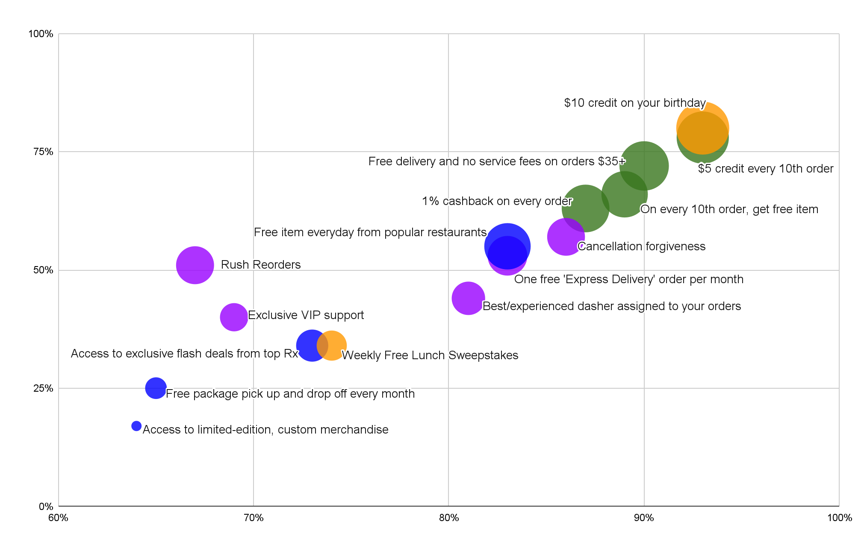
Affordability benefits have greatest use, understanding & impact
Ease of Understanding, Usefulness and Impact of Potential Benefits
Bubble size indicates impact:
Less Impactful
More Impactful
Surprise & Delight
Affordability
Very/Somewhat Useful
Exclusives
Quality & Experience
Very/Somewhat Easy to Understand
Total N=2708, Power Cx n=571, Habit Cx n=256, Core Net Savers n=575, Dormant Cx n=164, Low Net Saver n=262, Net Loser n=352, Early Paid Subs n=285, Trial Cx n=292

Slide 30
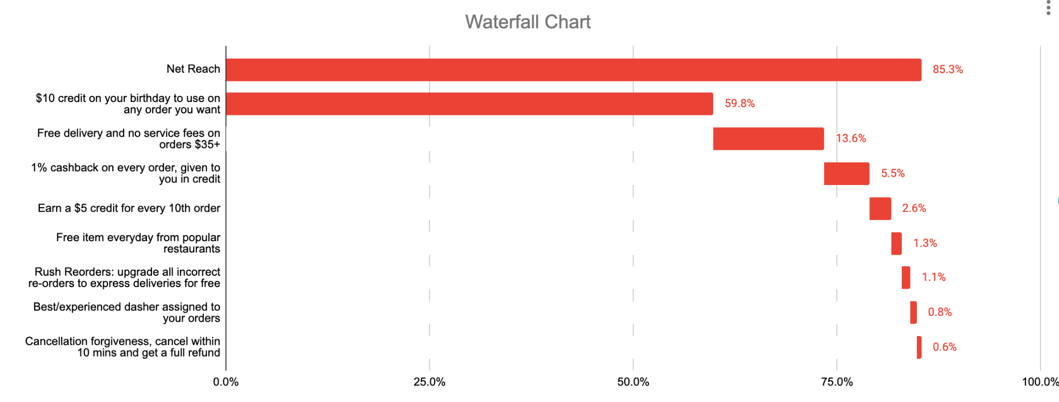
Additional impact becomes nominal once birthday credits and free delivery on $35+ orders are provided.
TURF allows us to see the potential increased reach of adding a combination of factors, letting us know additions that will have a major increase in reach vs. minimal increase in reach. This chart helps us understand that we do not need more than 2 affordability features to have a strong impact and interest up to 80% of the DashPass population in participation.
As we finalize our potential benefits as a team we can continue to explore further combinations using TURF simulator
How likely are you to participate in the DoorDash loyalty program based on each of the following benefits?
Total N=2708, Power Cx n=571, Habit Cx n=256, Core Net Savers n=575, Dormant Cx n=164, Low Net Saver n=262, Net Loser n=352, Early Paid Subs n=285, Trial Cx n=292

Slide 31
A quick recap
Affordability related rewards have the greatest potential to impact behavioral change, recommend experimenting with
Free delivery and no service fees on orders $35+
On every 10th order, get an item for free (Particularly among Habit & Core Cx)
$10 birthday reward also has a strong impact as well as high levels of clarity and usefulness; it is highest among less active users like “Dormant” and “Net Losers”
Quality and experience benefits make sense but are less likely to move the needle for Cx, consider experimenting with “Cancellation forgiveness” and adding quantification for others (e.g. Express Delivery: Save up to 10 mins in delivery time)
Little interest and clarity for exclusive benefits
Do not recommend including exclusive offers in top tiers, instead user lower tier loyalty hubs to educate on the availability of the benefits with DashPass

Slide 32
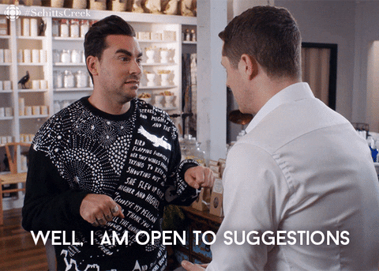
Recommendations

Slide 33

Recommended Benefits
Recommended Benefits for Loyalty Top Tier:
Earn a $5 credit on every 10th order
Free delivery and no service fees on orders $35+
Free item every day from popular restaurants
Cancellation Forgiveness OR 1 Express Order Per Month
Why?
Recommend Earn a $5 credit on every 10th order and Free delivery and no service fees on orders $35+ because they are both highly rated but include an action that can potentially impact behavior over time
These benefits are highly rated among Core Net Savers and Habit Cx
Do not recommend a birthday credit as this is most appealing to Dormant, Net Losers and Low Net Losers who will rely on the consistency/timing of this, rather than a behavioral change
Recommend “Free item everyday” as this scored high among lower frequency users and may help to increase frequency if Cx are actively looking for the “deal of the day”
Recommend exploring ways to quantify the value of Cancellation Forgiveness and/or express orders to increase clarity and usefulness metrics of these offers
For example Express Orders can be described in time saved

Slide 34
Loyalty Program Recommendations
Clear communication of program requirements is key. Cx are most frustrated by loyalty programs that are constantly moving the needle or changing the fine print. Keeping it simple, straightforward and upfront from the start is critical to success.
Birthday rewards & “earn as you go” are becoming market standards for loyalty programs. Top rated programs offer this and Cx in those programs expect similar offers from other programs.
Lower loyalty tiers should educate on existing benefits. Awareness of benefits outside of $0 delivery is low among all segments. Entry into the loyalty program should help to educate Cx on these additional benefits, particularly for early subs and trial Cx
All benefits should have a clear quantification of value. Benefits that clearly state how Cx will experience value have higher importance, clarity and useful ratings. Cx think about their value in terms of money saved, freebies, time saved and frustration/stress removed. (source)
1.
2.
3.
4.

Slide 35

Any Questions
Want to explore the data further? See data tables here

Slide 36
Appendix

Slide 37
Awareness of Benefits
 | Total | Power Cx | Habit Cx | Core Net Saver | Low Net Saver | Net Loser | Dormant Cx | Early Paid Subs | Trial Cx
$0 delivery fees | 93% | 95% | 96% | 93% | 89% | 91% | 92% | 92% | 93%
Reduced service fees | 58% | 63% | 56% | 64% | 60% | 53% | 57% | 61% | 46%
Exclusive promotions and discounts | 23% | 27% | 23% | 23% | 21% | 25% | 26% | 22% | 18%
5% credit back on pickup orders | 23% | 29% | 23% | 22% | 24% | 23% | 25% | 23% | 12%
Priority customer support | 9% | 15% | 12% | 8% | 8% | 10% | 9% | 7% | 6%
Exclusive menu items | 7% | 12% | 5% | 8% | 6% | 6% | 6% | 8% | 5%
On-demand grocery | 7% | 11% | 6% | 5% | 7% | 6% | 7% | 8% | 3%
Exclusive restaurants | 5% | 6% | 5% | 5% | 6% | 5% | 6% | 5% | 4%
Seamless cancellation | 4% | 6% | 2% | 4% | 5% | 4% | 4% | 4% | 2%
Limited edition products designed in partnership with celebrities &/or brands | 2% | 3% | 2% | 2% | 2% | 2% | 2% | 3% | 1%
Total N=2708, Power Cx n=571, Habit Cx n=256, Core Net Savers n=575, Dormant Cx n=164, Low Net Saver n=262, Net Loser n=352, Early Paid Subs n=285, Trial Cx n=292

Slide 38




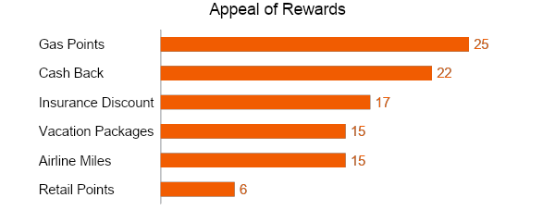
Standard MaxDiff
EXAMPLE QUESTION
What it is:
Standard MaxDiff is a form of trade-off used to prioritize lists of attributes, messages, concepts etc.
It pits sets of items against each other to determine importance, appeal, preference, etc.
Within each set, respondents are asked to choose the most and least important, appealing, preferred, etc.
Why we do it:
Simple and easy for respondents
It’s more accurate because it derives the preferences of respondents, rather than asks it
Eliminates scale use bias
Effective at identifying differences between respondents and items
Considerations:
More time consuming than rating scales
Results are purely relative
Look at the below reward offers, and select the one that would be most appealing, and the one that would be least appealing:
Reward |  | Most Appealing | Least Appealing
 | Up to 5% Discount on Policy | ● | ●
 | Airline Miles | ● | ●
 | Cash for Gas | ● | ●
 | Cash Back | ● | ●
SAMPLE DELIVERABLE

Slide 39
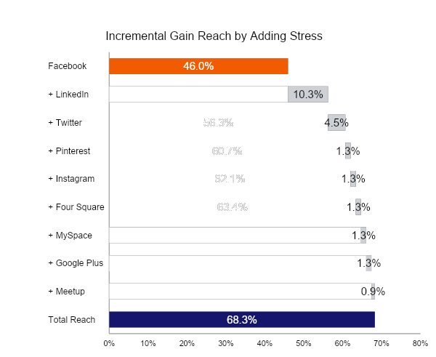
TURF
SAMPLE DELIVERABLE
What it is:
Looks across a set of 0/1 variables looking for patterns of uniqueness
Searches through millions of possible combinations, and reports back the reach and the frequency of combos
Reach: the number of cases that have at least N positive responses on the variables in that combination (typically, the most focused on measure)
Frequency: for the reached cases, normally the total number of positive responses on the variables in the combination
Why we do it:
Great at finding the highest reach for activities, TV shows watched, magazines read, desired features, etc.
Can use it using any set of 0/1 data (we can recode 0-10 scale data into 0/1 data)
Point of diminishing return: 68.3%

